Slide 1
Welcome

Slide 2
Teacher Acquaint
MD. Al Amin
Lecturer
Govt.Abdul Jabbar College
Borhanuddin,Bhola
01729812141

Slide 3
Curriculum acquaint
Class: Eight
Subject :English 2nd paper
Time:45 minutes

Slide 4
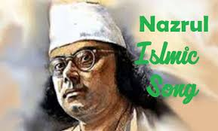
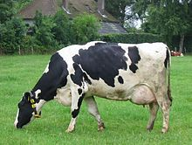
What is this picture
Kaji Nozrul Islam
A Cow

Slide 5
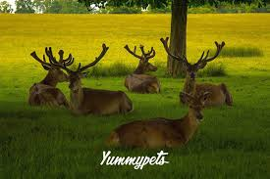
Today lesson is Noun

Slide 6
Objectives
After the lesson students will be able to:
*Identify different kinds of noun.
*write structure of proper noun, common noun, collective noun , Material noun and abstract noun.
*Use noun in proper situation.

Slide 7
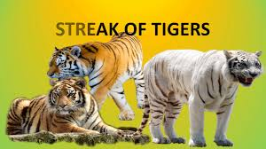
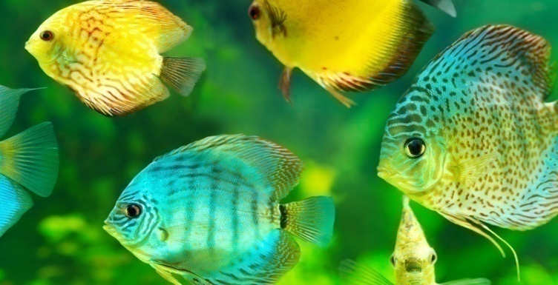
Noun
A Noun is The Name of Anything. Such as:
Fish
Tiger

Slide 8
Kinds of Noun
1)Proper Noun
2)Common noun
3)Collective Noun
4) Material Noun
5)Abstract Noun

Slide 9
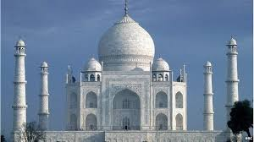
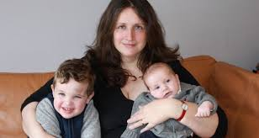
Proper Noun
A person Noun refers to specific names of person, thing , thing,places etc. and always start with a capital letter.
TAJMOHOL
PERSON

Slide 10
Common
A common Noun refers to specific names of person,place,things,etc.

Slide 11
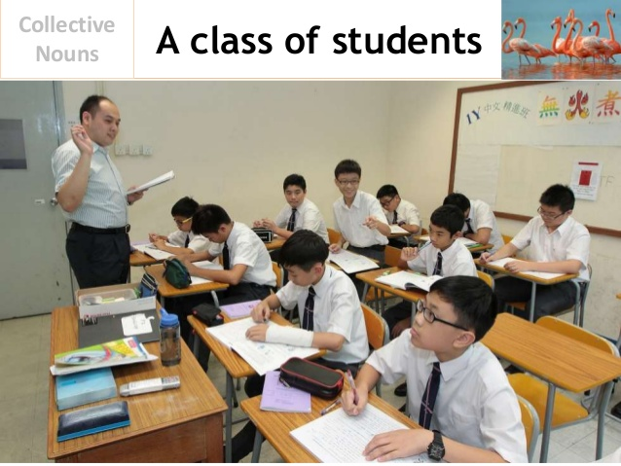
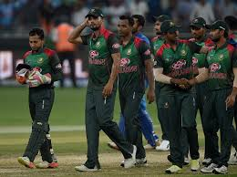
Collective Noun
Collective Noun, in English Grammer refers To a group of things, persons,animals.
Class
Team

Slide 12
Material Noun
Material noun is an uncountable noun,its substances or material that we can see and touch but can not count.
Gold
Glass

Slide 13
Abstract Noun
Abstract nouns,expres,ideas,feelings,realization and qualities that we can not see, touch, hear, taste or smell. we can understand and imagine it but can not even see

Slide 14
Pair work
1)What do you mean noun.
2)Write different kinds of noun

Slide 15
Group work
Write 10 sentence in noun about the things that will happen around you.

Slide 16
Home work
Identify the noun of underlined words
1)Honesty is the best policy.
2)Iron is a useful metal.
3)I met him in the party.
4)The boy is meritorious.
5)Dhaka is abig city.

Slide 17
Thanks

